Slide 1
sales view by tableau
File created on: 11/15/2022 3:31:16 PM

Slide 2


Slide 3


Slide 4
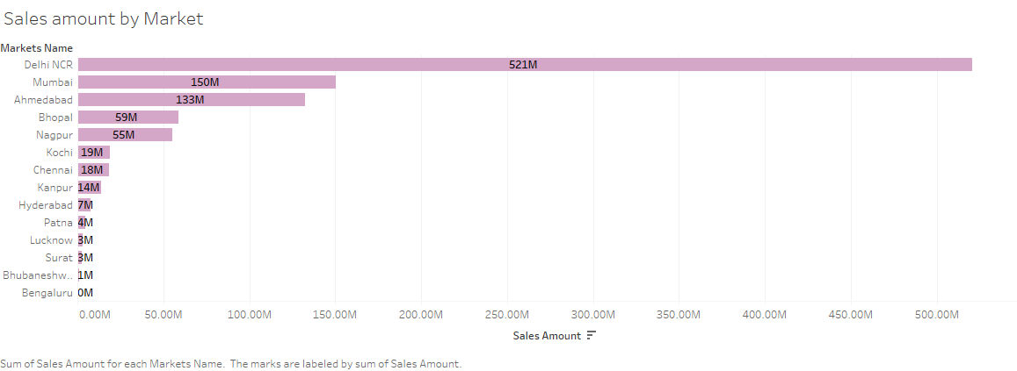

Slide 5
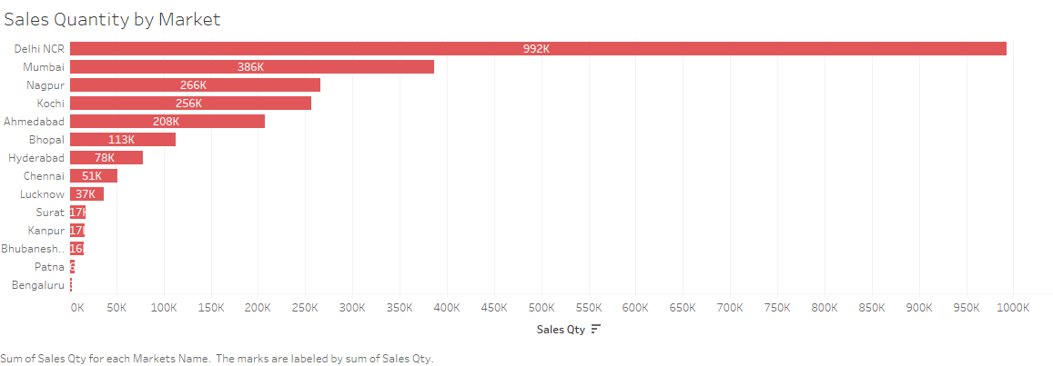

Slide 6
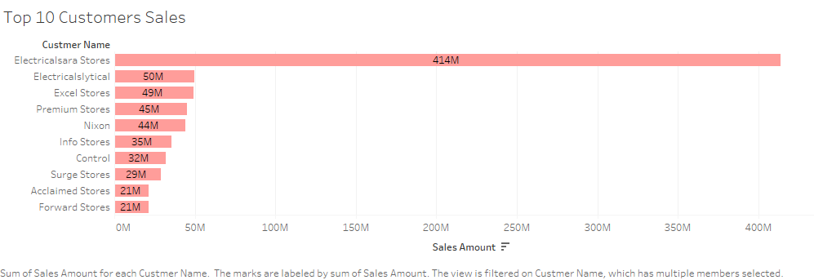

Slide 7


Slide 8


Slide 9
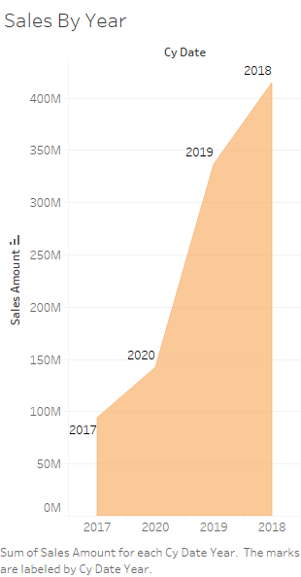

Slide 10
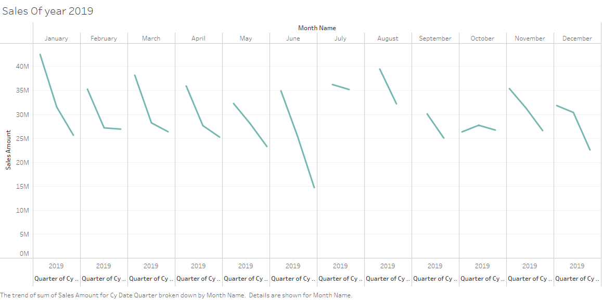

Slide 11


Slide 12
